Slide 1

What drives species distributions?
Petr Keil
Notes:
Hi, my name is Petr Keil and this is my project Biodiversity dynamics across a continuum of space, time, and their scales.

Slide 2
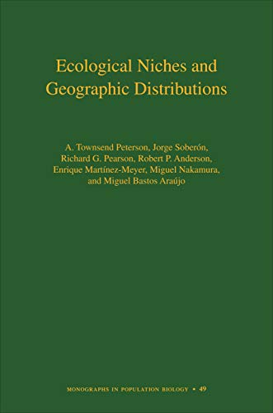
Contents
Ecological niche
Optima, limits
Eltonian vs Grinnellian niche
Fundamental vs Realized niche
Abiotic vs Biotic niche
Phenotypic plasticity, lessons from invasions, time-for-space
SDMs, niche models, applied issues
Climate
Habitats and biomes
Dispersal limits, historical legacies
Townsend Peterson et al. (2011) Ecological Niches and Geographic Distributions. Princeton
Notes:
In this panel we can probably all agree that biodiversity is one of the most valuable natural resources.
But things like climate change or habitat loss are a threat to biodiversity, to the extent that we hear about biodiversity crisis, or sixth mass extinction
For example, about 1% of vertebrate species have gone extinct because of humans

Slide 3
Ecological niche
The fundamental concept of ecology
Notes:
I am qualified to deliver all this

Slide 4
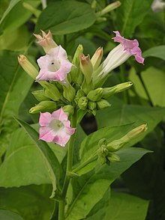
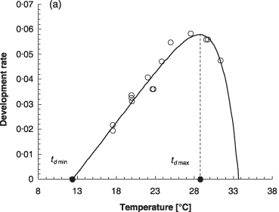
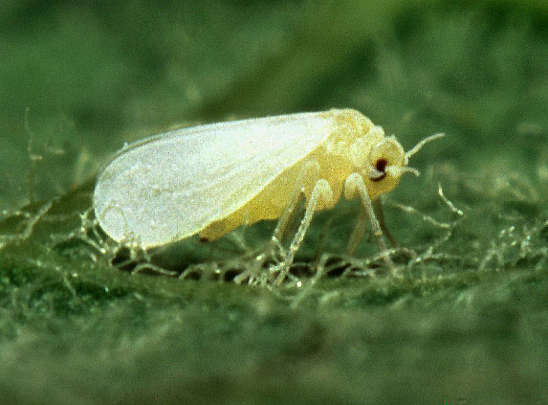
Environment, resources, biotic vs abiotic variables
Resources or “linked” variables (Hutchinson 1978) - consumed/modified by organisms, there may be competition for the resources; hard to include in models
Scenopoetic variables (from Greek “setting the stage”) or “non-linked” variables (Hutchinson 1978) or conditions - those that aren’t modified = climate, topography, pH; easy to include in models
Biotic vs abiotic variables
Bemisia tabaci
Nicotiana tabacum
Dixon, Honek, Keil et al. (2009) Functional Ecology
Photos: Wikipedia
Notes:
In this panel we can probably all agree that biodiversity is one of the most valuable natural resources.
But things like climate change or habitat loss are a threat to biodiversity, to the extent that we hear about biodiversity crisis, or sixth mass extinction
For example, about 1% of vertebrate species have gone extinct because of humans

Slide 5
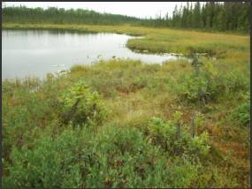
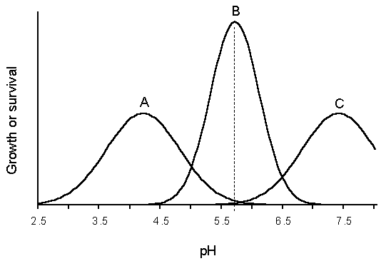
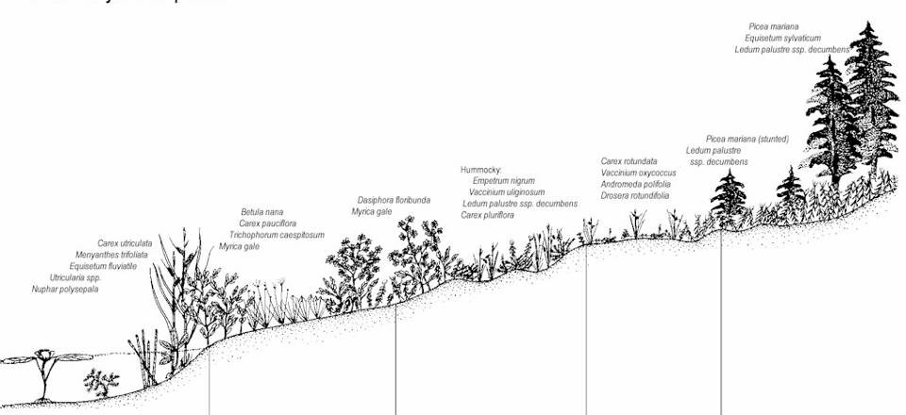
Niche – one dimension
Growth or survival
wet
dry
Notes:
In this panel we can probably all agree that biodiversity is one of the most valuable natural resources.
But things like climate change or habitat loss are a threat to biodiversity, to the extent that we hear about biodiversity crisis, or sixth mass extinction
For example, about 1% of vertebrate species have gone extinct because of humans

Slide 6
Niche – one dimension
optimum
Abundance
Fitness
Survival
Growth rate
There are many ways to model a niche, it doesn’t have to be this idealized Gaussian response.
limit
limit
Helaouet & Beaugrand (2009) Ecosystems
Temperature
Notes:
In this panel we can probably all agree that biodiversity is one of the most valuable natural resources.
But things like climate change or habitat loss are a threat to biodiversity, to the extent that we hear about biodiversity crisis, or sixth mass extinction
For example, about 1% of vertebrate species have gone extinct because of humans

Slide 7
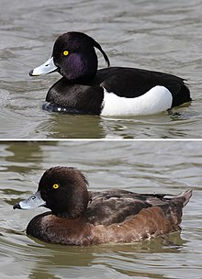
Example of a “non-Gaussian” niche: step response
Probability of presence
Water area
Aythya fuligula
(polák chocholačka)
For water birds, mere presence or absence of a critical water area is more important than its amount.
Gabor, Simova, Keil et al. (2022) Ecography
Notes:
In this panel we can probably all agree that biodiversity is one of the most valuable natural resources.
But things like climate change or habitat loss are a threat to biodiversity, to the extent that we hear about biodiversity crisis, or sixth mass extinction
For example, about 1% of vertebrate species have gone extinct because of humans

Slide 8
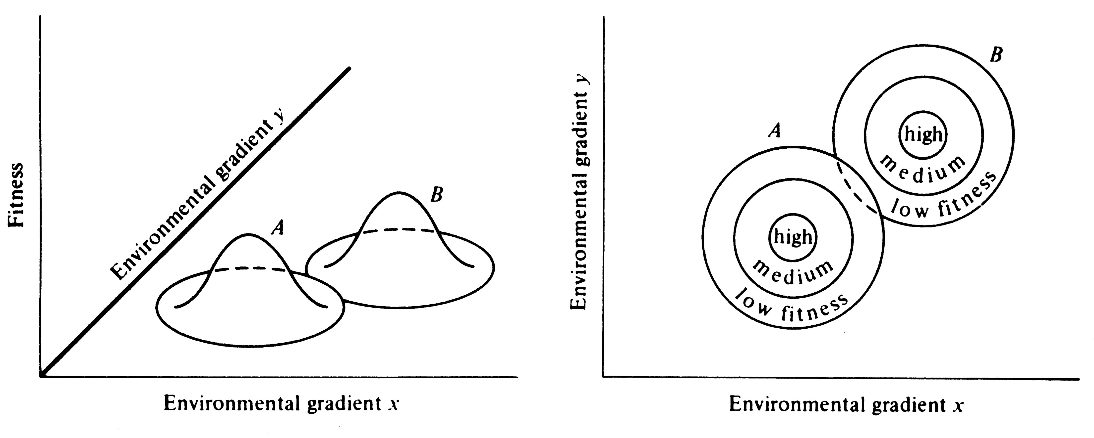
Niche – two and more dimensions
http://www.zo.utexas.edu/courses/bio373/chapters/Chapter13/Chapter13.html
Notes:
In this panel we can probably all agree that biodiversity is one of the most valuable natural resources.
But things like climate change or habitat loss are a threat to biodiversity, to the extent that we hear about biodiversity crisis, or sixth mass extinction
For example, about 1% of vertebrate species have gone extinct because of humans

Slide 9
The confusing multitude of definitions of ecological niche
Hutchinson (1957): The total range of conditions under which an individual (or population) lives and replaces itself.
Grinnell (1917, 1924, 1928): Grinnellian niche = conditions or requirements for existence, mostly in the context of scenopoetic variables, e.g. climate
Elton (1927): Eltonian niches = Niche as an impact of the organisms, a.k.a. functional role of the organism in the community (existence is granted, given)
Silvertown (2006):
Alpha niche: at local scale where interactions with other species occur
Beta niche: the broad habitat where the species is found
Gamma niche: geographic range of species
We will focus on Beta and Gamma
Townsend Peterson et al. (2011) Ecological Niches and Geographic Distributions. Princeton
Notes:
In this panel we can probably all agree that biodiversity is one of the most valuable natural resources.
But things like climate change or habitat loss are a threat to biodiversity, to the extent that we hear about biodiversity crisis, or sixth mass extinction
For example, about 1% of vertebrate species have gone extinct because of humans

Slide 10
Fundamental vs. realized niche
Hutchinson:
Fundamental niche = a set of all scenopoetic variables where species can exist
Realized niche = subset of fundamental niche where the species is competitive and can survive biotic interactions
Precipitation
Temperature
Townsend Peterson et al. (2011) Ecological Niches and Geographic Distributions. Princeton
Notes:
In this panel we can probably all agree that biodiversity is one of the most valuable natural resources.
But things like climate change or habitat loss are a threat to biodiversity, to the extent that we hear about biodiversity crisis, or sixth mass extinction
For example, about 1% of vertebrate species have gone extinct because of humans

Slide 11
Potential vs realized geographic range
Hutchinson:
Fundamental niche = a set of all scenopoetic variables where species can exist
Realized niche = subset of fund niche where the species is competitive and can survive biotic interactions
Realized vs potential range
Precipitation
Temperature
Townsend Peterson et al. (2011) Ecological Niches and Geographic Distributions. Princeton
Notes:
In this panel we can probably all agree that biodiversity is one of the most valuable natural resources.
But things like climate change or habitat loss are a threat to biodiversity, to the extent that we hear about biodiversity crisis, or sixth mass extinction
For example, about 1% of vertebrate species have gone extinct because of humans

Slide 12
Geographic vs environmental space
Townsend Peterson et al. (2011) Ecological Niches and Geographic Distributions. Princeton
Notes:
In this panel we can probably all agree that biodiversity is one of the most valuable natural resources.
But things like climate change or habitat loss are a threat to biodiversity, to the extent that we hear about biodiversity crisis, or sixth mass extinction
For example, about 1% of vertebrate species have gone extinct because of humans

Slide 13
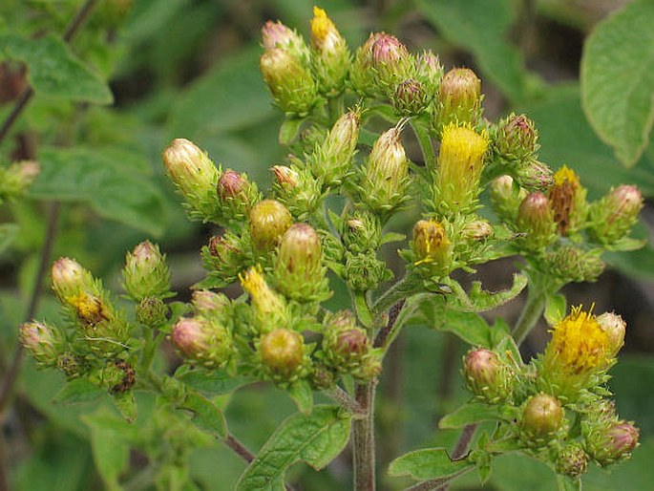
Geographic vs environmental space
Inula conyzae (Oman hnidák)
One location in climatic space may correspond to multiple locations in geographic space, but not the other way round.
Sporbert, Keil et al. (2019) J. Biogeogr.
Notes:
In this panel we can probably all agree that biodiversity is one of the most valuable natural resources.
But things like climate change or habitat loss are a threat to biodiversity, to the extent that we hear about biodiversity crisis, or sixth mass extinction
For example, about 1% of vertebrate species have gone extinct because of humans

Slide 14
Ecological Niche Models
a.k.a. Species Distribution Models (SDM)
Notes:
I am qualified to deliver all this

Slide 15
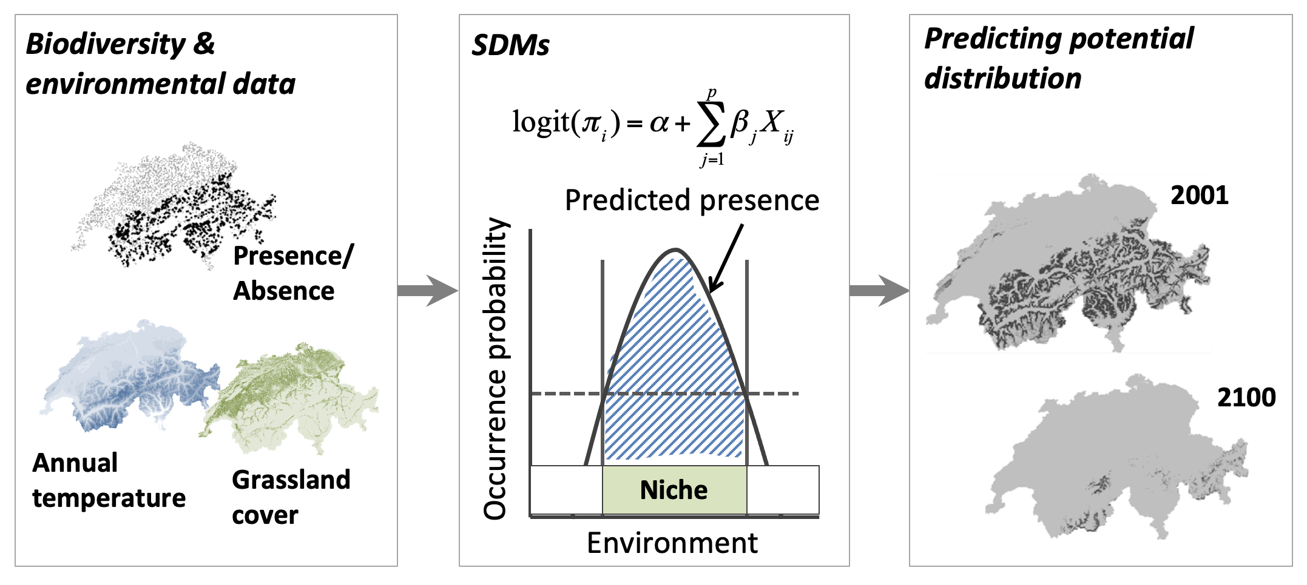
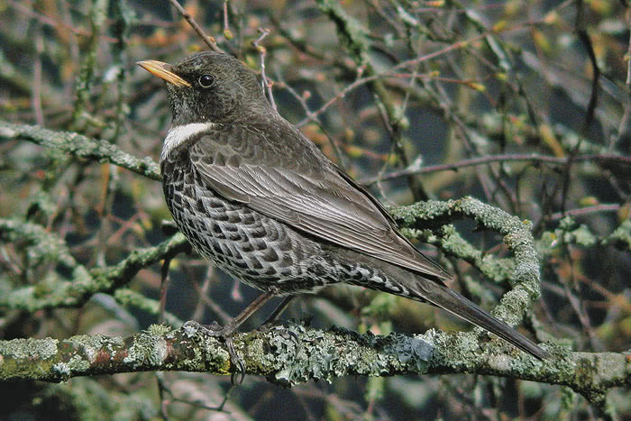
Niche models a.k.a. Species Distribution Models (SDM)
Turdus torquatus
(kos horský)
Algorithms that guess niche from geographic distribution of species, and then project the niche to un-surveyed locations (or times).
For more info on how SDMs work see the upcoming practical class!
Scheme by Damaris Zurell: https://damariszurell.github.io/SDM-Intro/
ENM 2020: https://journals.ku.edu/jbi/article/view/15016
Notes:
In this panel we can probably all agree that biodiversity is one of the most valuable natural resources.
But things like climate change or habitat loss are a threat to biodiversity, to the extent that we hear about biodiversity crisis, or sixth mass extinction
For example, about 1% of vertebrate species have gone extinct because of humans

Slide 16
Applications of SDM
Predicting into un-surveyed times and locations (we can’t look everywhere)
Future projections under climate change
Species discovery
Disease vector mapping
Conservation biology
Characterizing potential distribution and invasion potential of species
Assessment of habitat requirements / niche
Niche evolution
Townsend Peterson et al. (2011) Ecological Niches and Geographic Distributions. Princeton
Notes:
In this panel we can probably all agree that biodiversity is one of the most valuable natural resources.
But things like climate change or habitat loss are a threat to biodiversity, to the extent that we hear about biodiversity crisis, or sixth mass extinction
For example, about 1% of vertebrate species have gone extinct because of humans

Slide 17
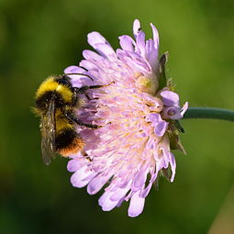
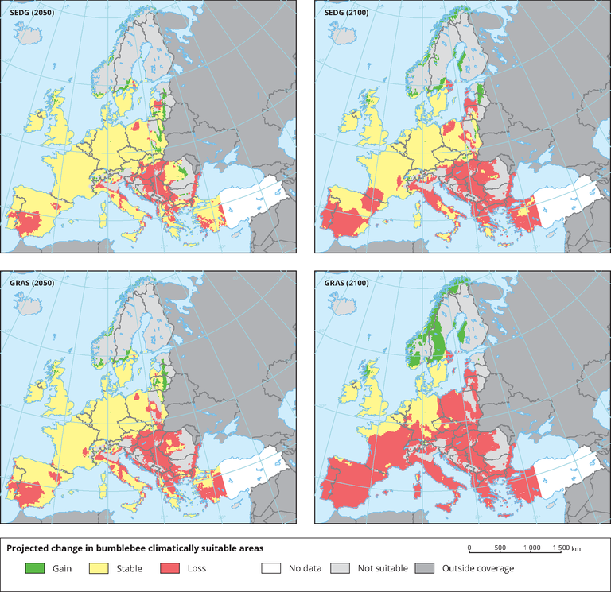
Future forecasts of diversity and distributions
Bombus campestris
It assumes time-for-space substitution. Can it work?
Rasmont et al. (2015) BioRisk
Notes:
In this panel we can probably all agree that biodiversity is one of the most valuable natural resources.
But things like climate change or habitat loss are a threat to biodiversity, to the extent that we hear about biodiversity crisis, or sixth mass extinction
For example, about 1% of vertebrate species have gone extinct because of humans

Slide 18
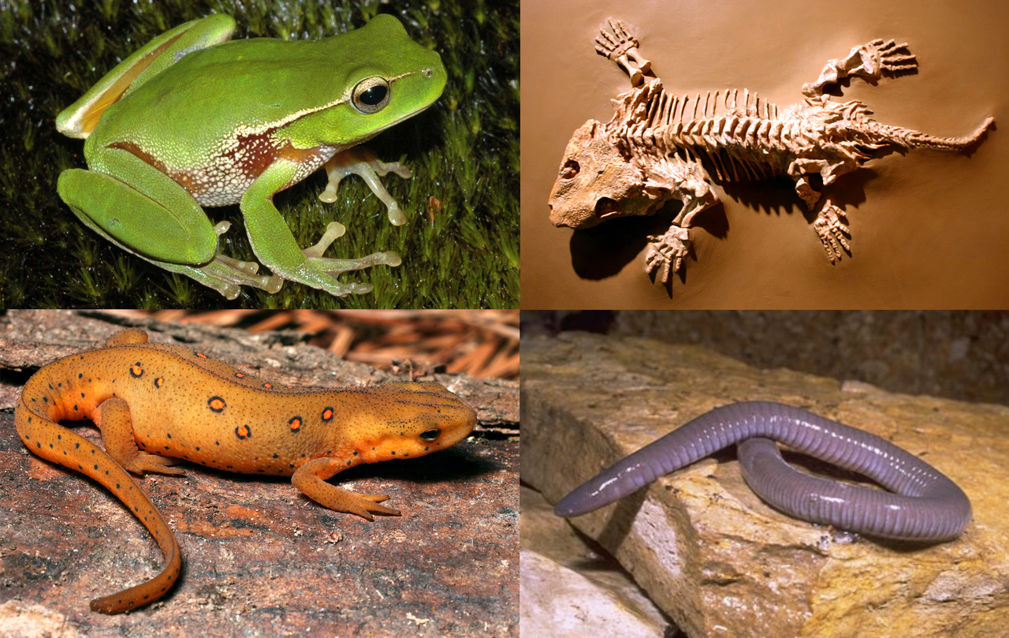
Future forecasts of diversity and distributions
Current amphibian richness
Projected future threat from climate change
It assumes time-for-space substitution. Can it work?
Hof et al. (2011) Nature
Notes:
In this panel we can probably all agree that biodiversity is one of the most valuable natural resources.
But things like climate change or habitat loss are a threat to biodiversity, to the extent that we hear about biodiversity crisis, or sixth mass extinction
For example, about 1% of vertebrate species have gone extinct because of humans

Slide 19
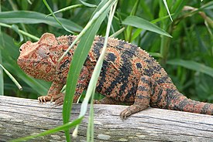
Discovering biodiversity
Furcifer oustaleti
“Notably, these models also identified three intersecting areas of over-prediction that recently yielded seven chameleon species new to science.”
Raxworthy et al. (2003) Nature
Notes:
In this panel we can probably all agree that biodiversity is one of the most valuable natural resources.
But things like climate change or habitat loss are a threat to biodiversity, to the extent that we hear about biodiversity crisis, or sixth mass extinction
For example, about 1% of vertebrate species have gone extinct because of humans

Slide 20
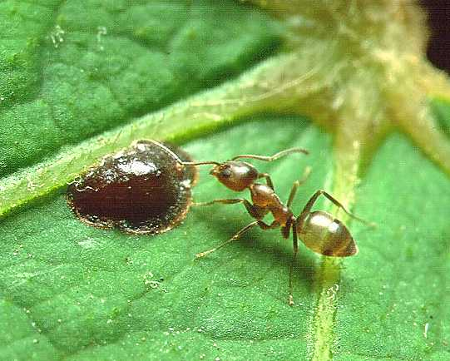
Invasion biology
Linephithema humile
(Mravenec argentinský)
Townsend Peterson et al. (2011)
Roura-Pascual et al. (2005)
Notes:
In this panel we can probably all agree that biodiversity is one of the most valuable natural resources.
But things like climate change or habitat loss are a threat to biodiversity, to the extent that we hear about biodiversity crisis, or sixth mass extinction
For example, about 1% of vertebrate species have gone extinct because of humans

Slide 21
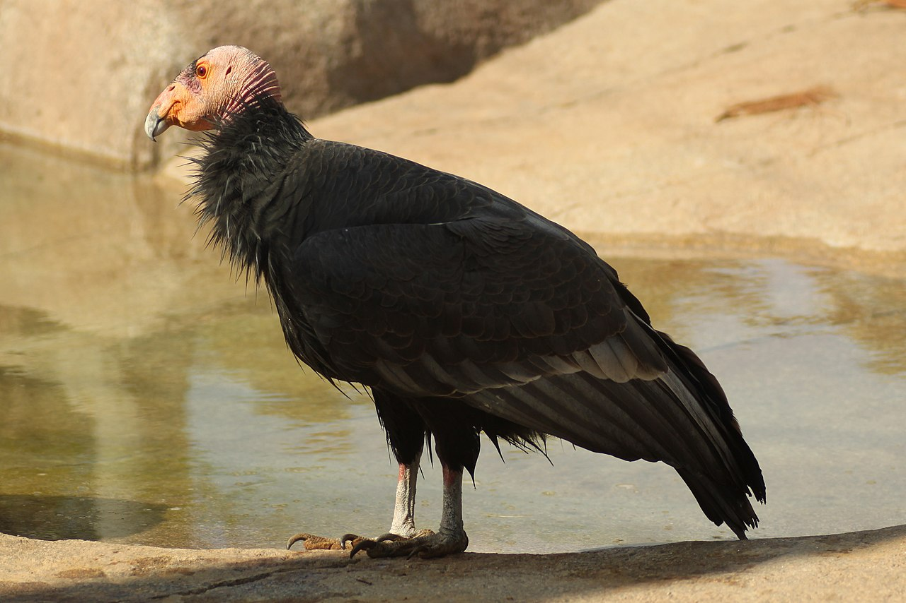
Reintroductions
Gymnogyps californianus
(Kondor kalifornský)
Townsend Peterson et al. (2011)
Martinez-Meyer et al. (2006)
Notes:
In this panel we can probably all agree that biodiversity is one of the most valuable natural resources.
But things like climate change or habitat loss are a threat to biodiversity, to the extent that we hear about biodiversity crisis, or sixth mass extinction
For example, about 1% of vertebrate species have gone extinct because of humans

Slide 22
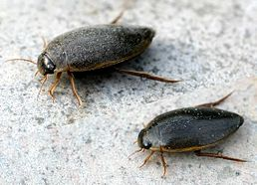
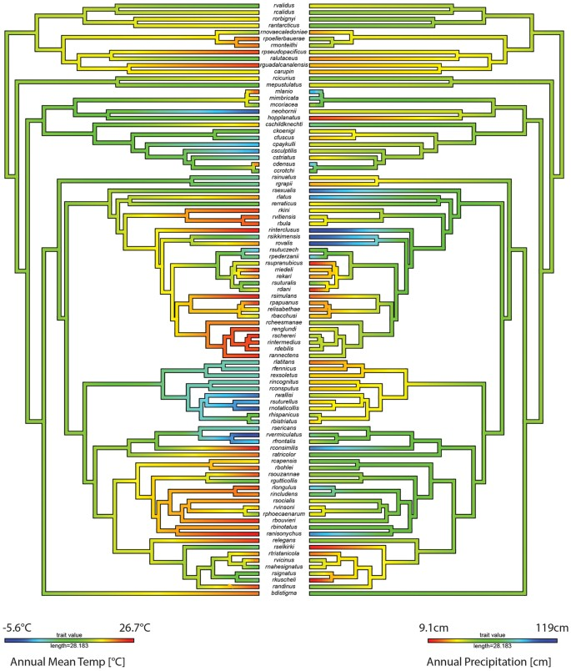
Evolutionary biology
Colymbetes fuscus
(Potápěč hnědý)
Moriniere et al. (2016) Sci. Rep.
Notes:
In this panel we can probably all agree that biodiversity is one of the most valuable natural resources.
But things like climate change or habitat loss are a threat to biodiversity, to the extent that we hear about biodiversity crisis, or sixth mass extinction
For example, about 1% of vertebrate species have gone extinct because of humans

Slide 23
Epidemiology – disease mapping
Coro (2020) Ecological Modelling
Carlson et al. (2020) Nature Ecol. Evol.
Notes:
In this panel we can probably all agree that biodiversity is one of the most valuable natural resources.
But things like climate change or habitat loss are a threat to biodiversity, to the extent that we hear about biodiversity crisis, or sixth mass extinction
For example, about 1% of vertebrate species have gone extinct because of humans

Slide 24
Main problems
Niche models often rely only on climate, while other complex mechanisms are at play
Time-for-space substitution may not work
Realized niches emerge due to geographic barriers
We often have presence-only data, i.e. we know where species is, but we don’t know where it isn’t.
Townsend Peterson et al. (2011) Ecological Niches and Geographic Distributions. Princeton
Notes:
In this panel we can probably all agree that biodiversity is one of the most valuable natural resources.
But things like climate change or habitat loss are a threat to biodiversity, to the extent that we hear about biodiversity crisis, or sixth mass extinction
For example, about 1% of vertebrate species have gone extinct because of humans

Slide 25
Drivers of distributions + data
Climate, biotic interactions, and dispersal limits
Notes:
I am qualified to deliver all this

Slide 26
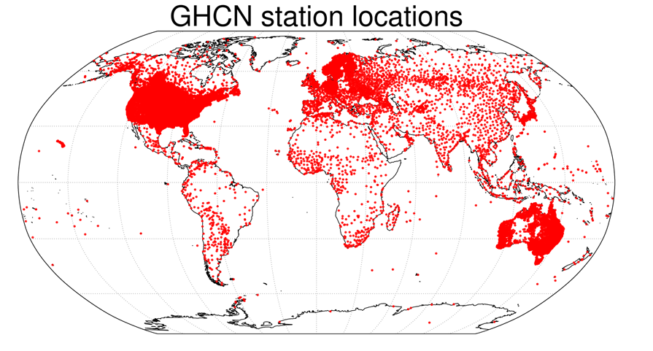
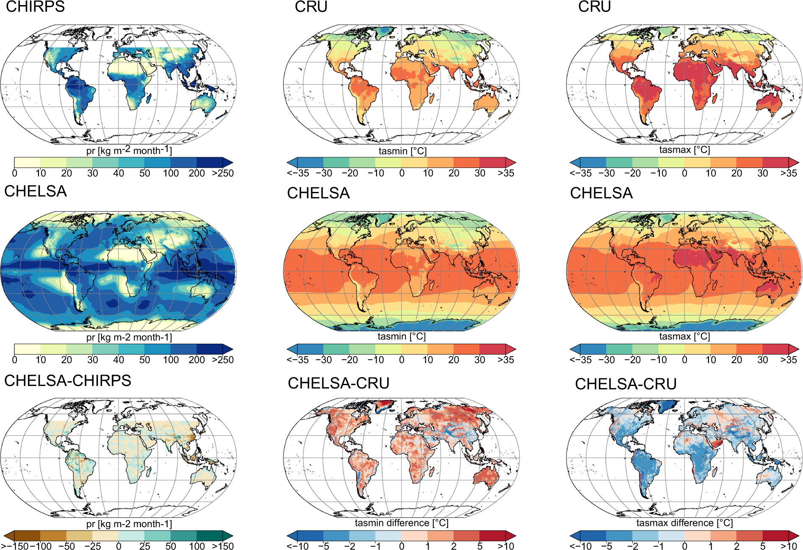
Climate – the #1 suspect behind large-scale ecological patterns
WorldClim: https://www.worldclim.org/
CHELSA: https://chelsa-climate.org/
Notes:
In this panel we can probably all agree that biodiversity is one of the most valuable natural resources.
But things like climate change or habitat loss are a threat to biodiversity, to the extent that we hear about biodiversity crisis, or sixth mass extinction
For example, about 1% of vertebrate species have gone extinct because of humans

Slide 27
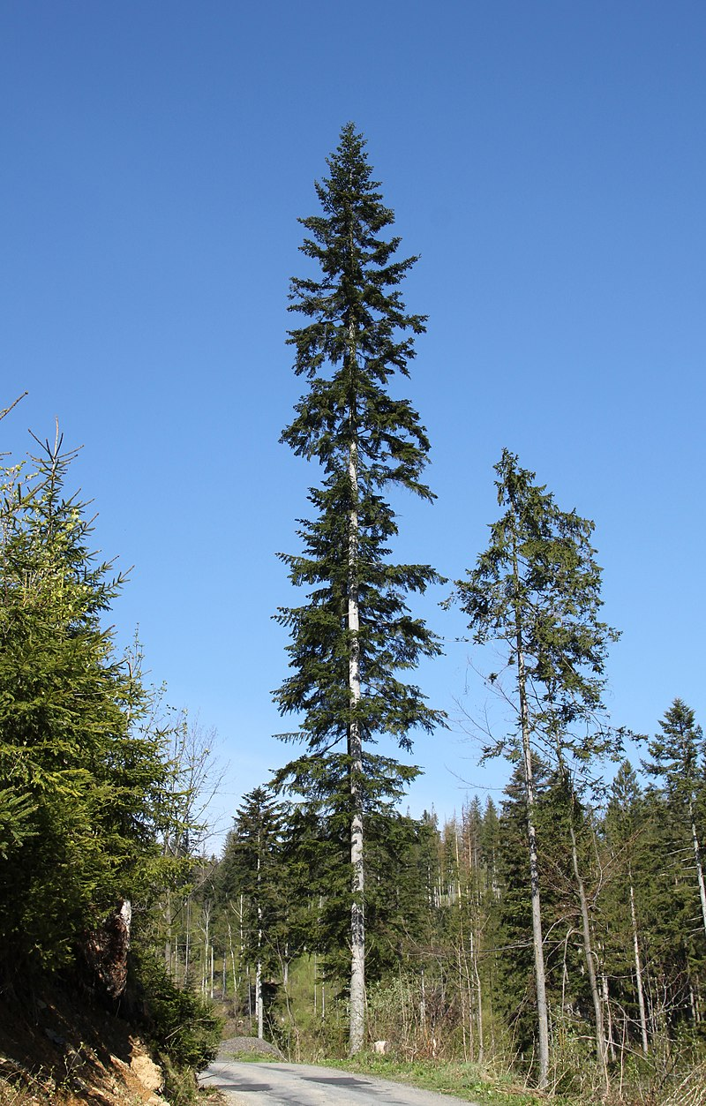
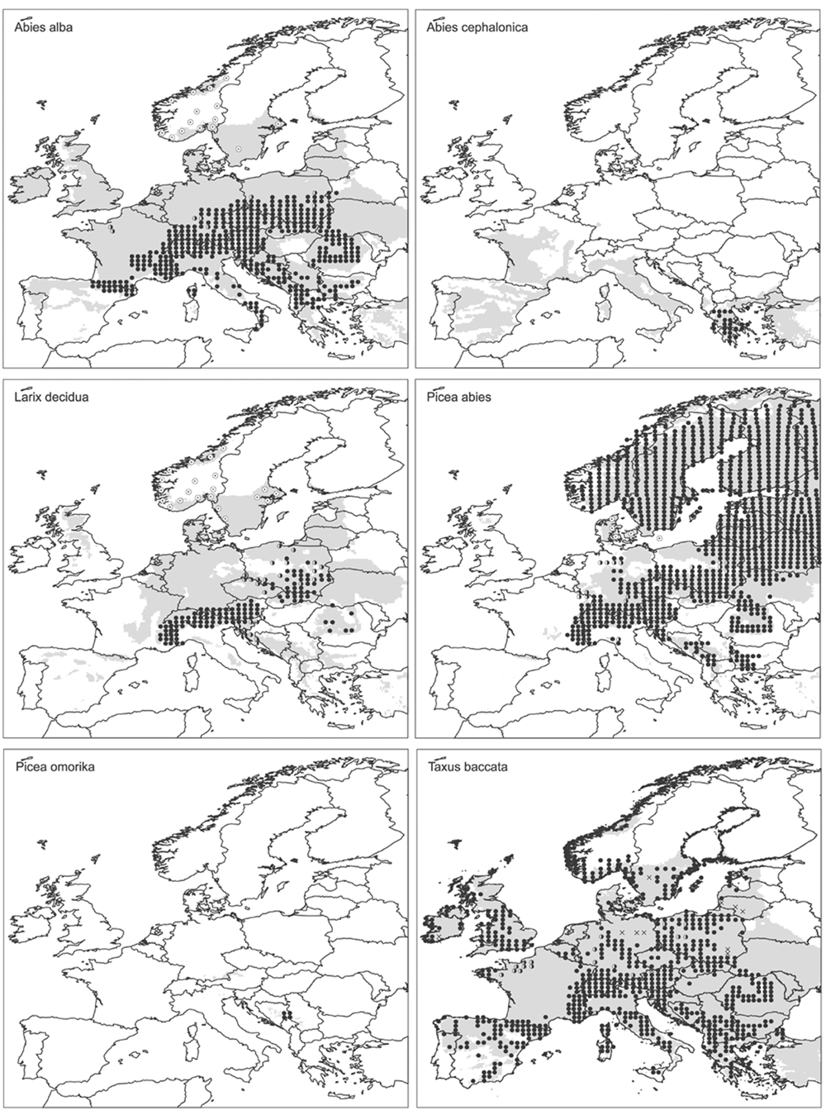
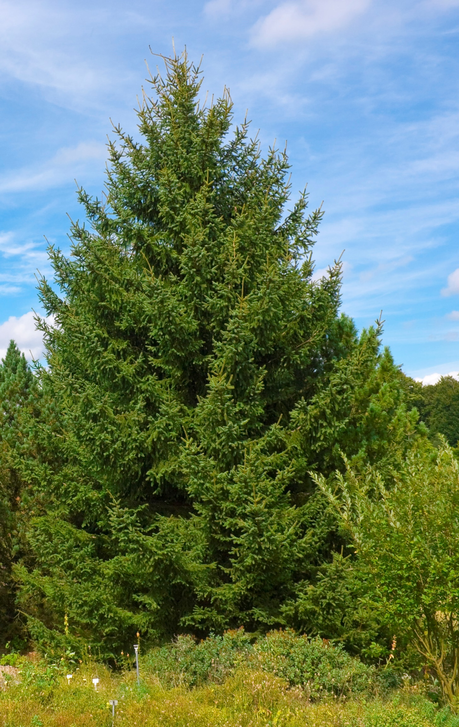
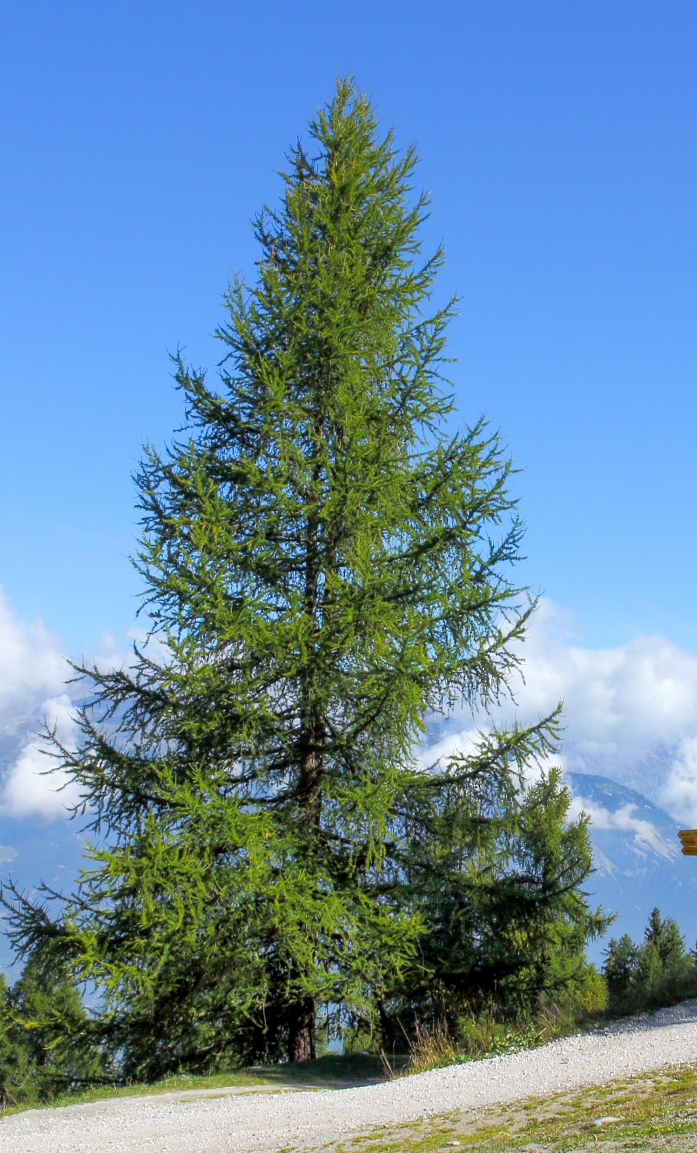
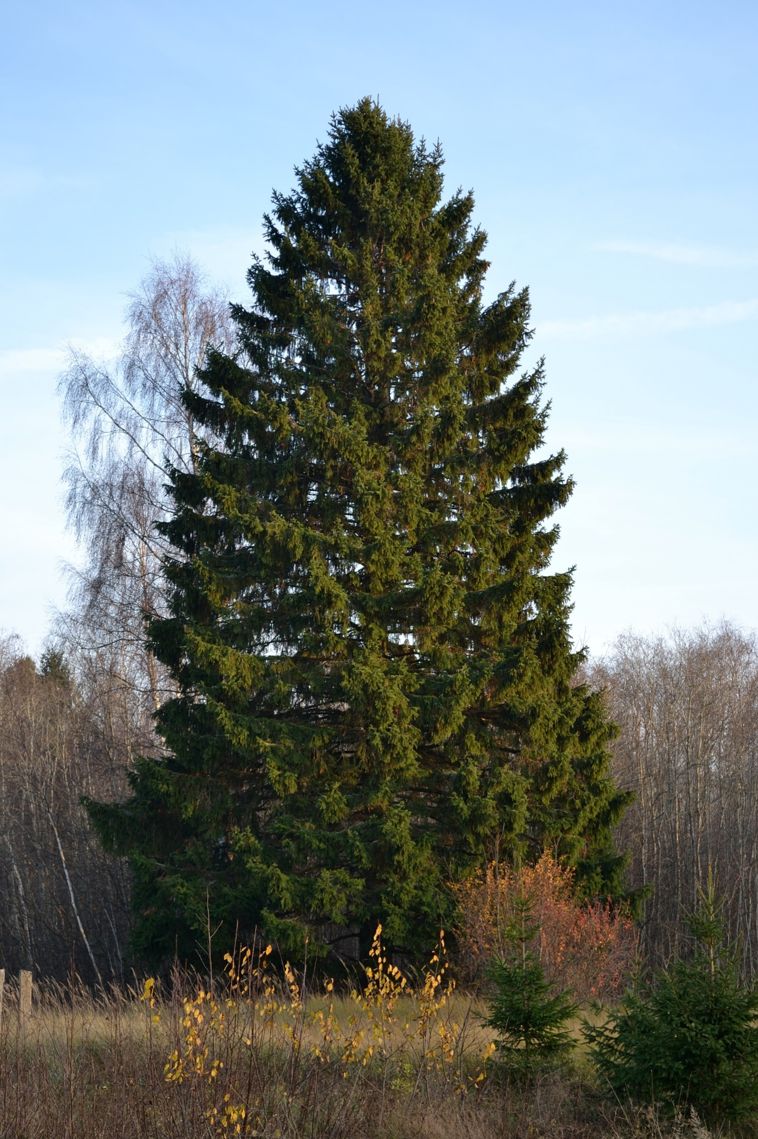
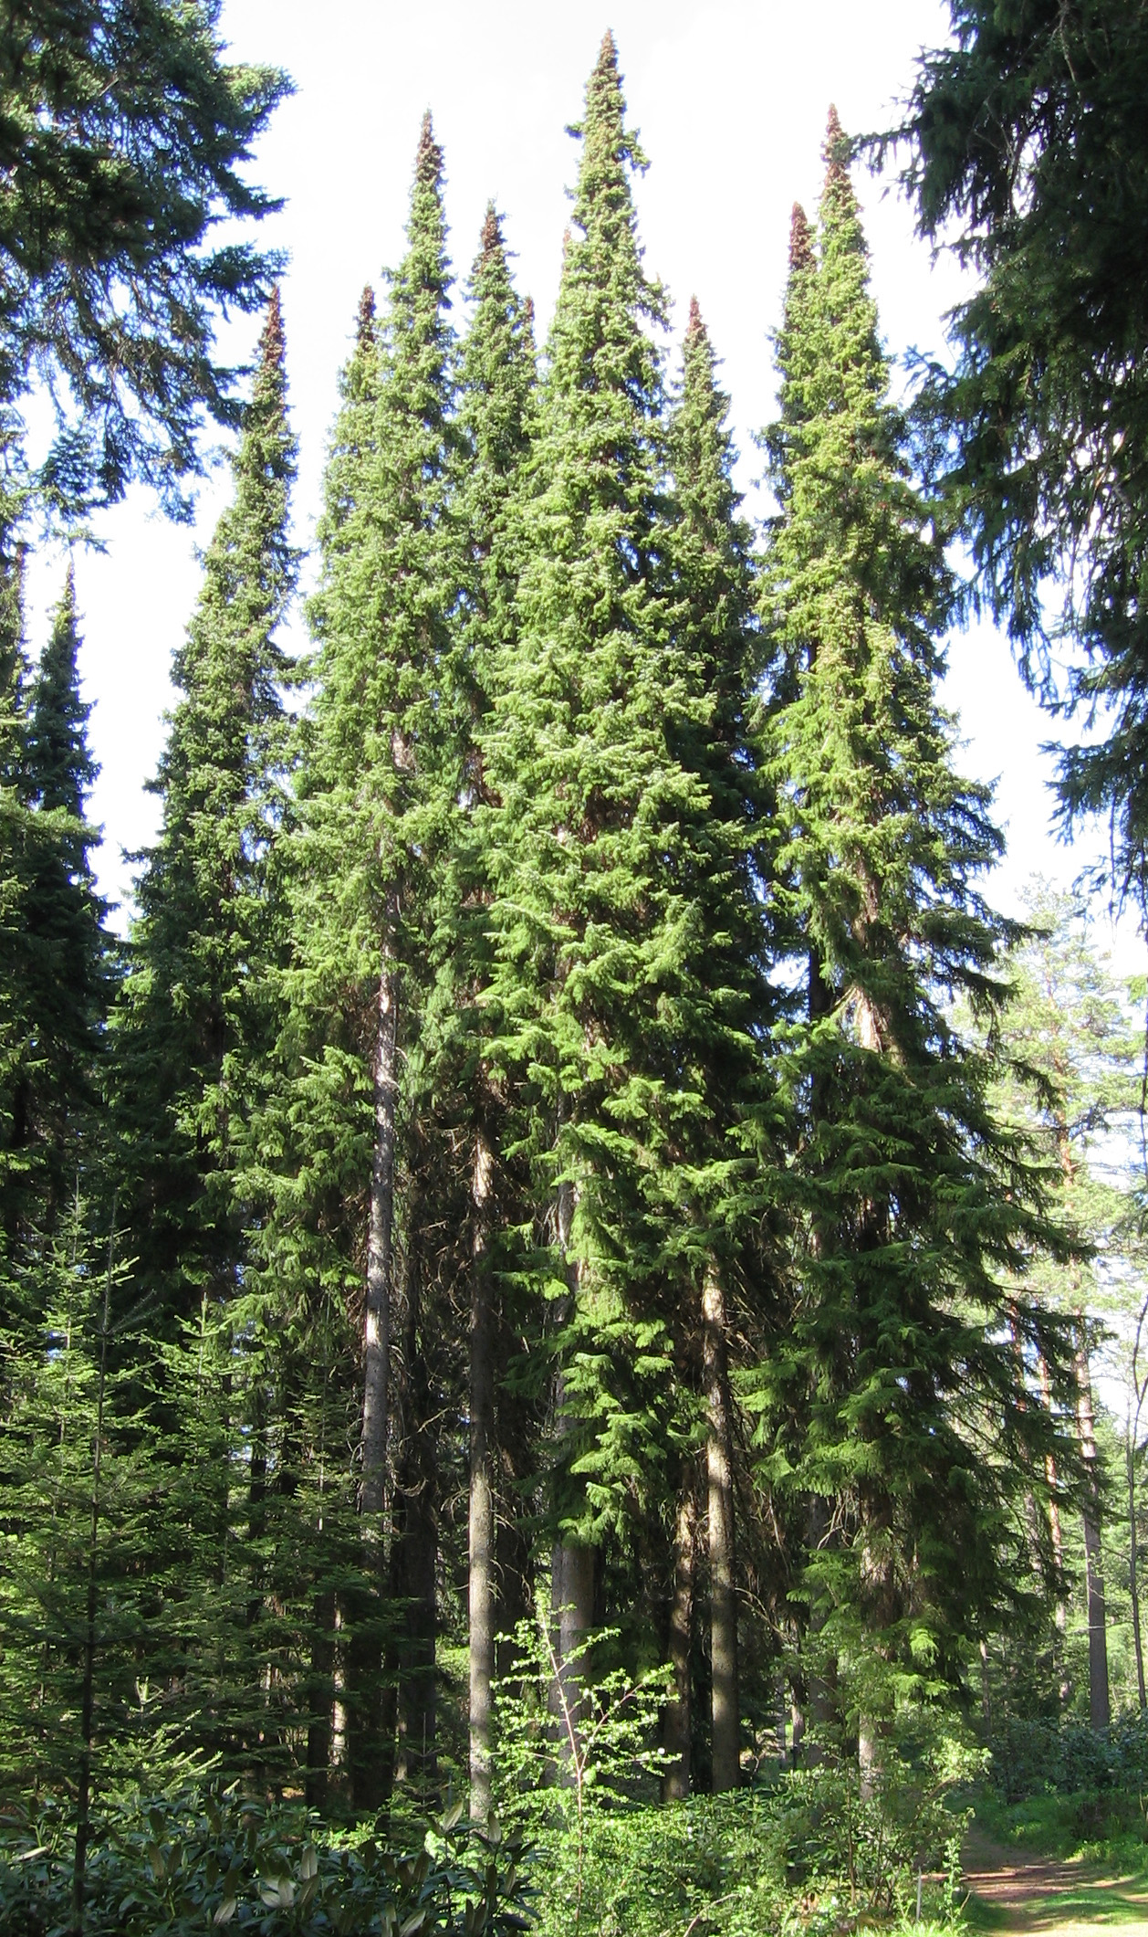
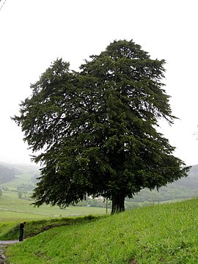
Dispersal limits
Species may be missing in parts of its range (B, C) and niche (E) because it can’t get there due to barriers or poor dispersal.
Svenning & Skov (2004) Ecology Letters
Notes:
In this panel we can probably all agree that biodiversity is one of the most valuable natural resources.
But things like climate change or habitat loss are a threat to biodiversity, to the extent that we hear about biodiversity crisis, or sixth mass extinction
For example, about 1% of vertebrate species have gone extinct because of humans

Slide 28
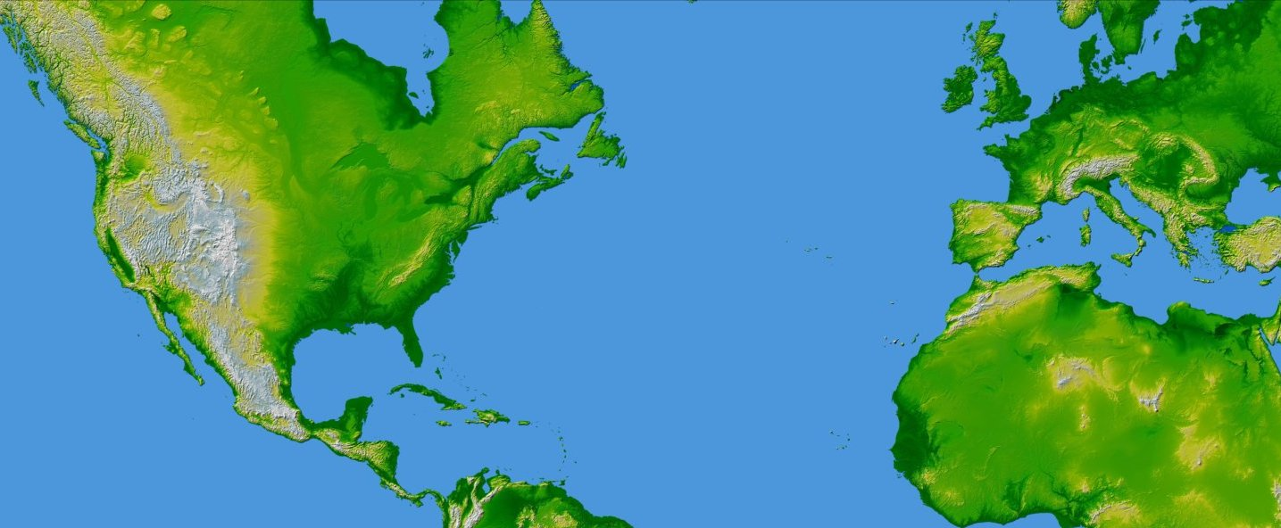
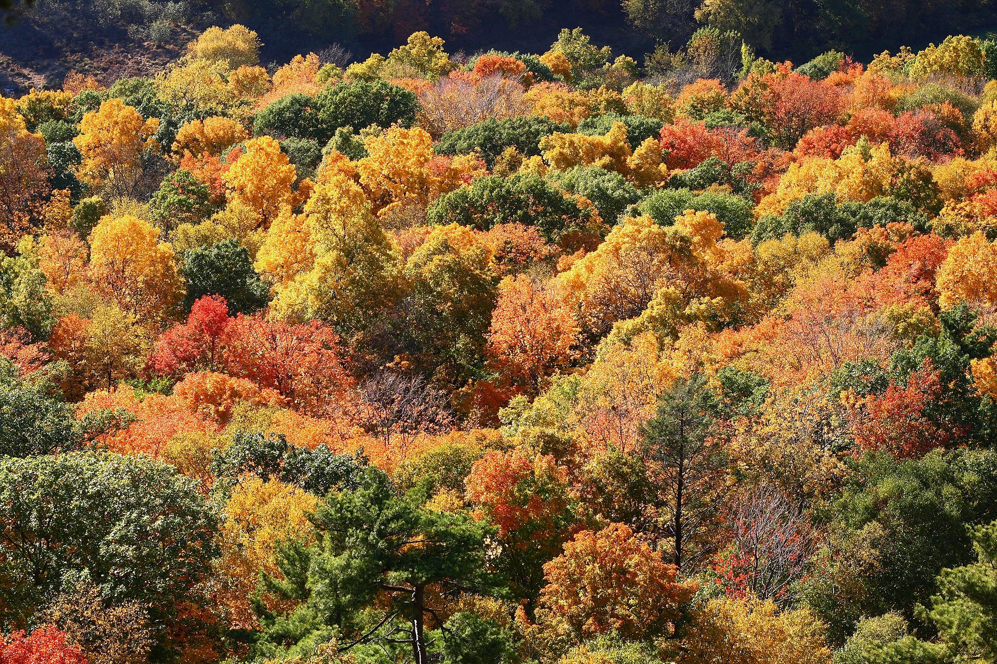
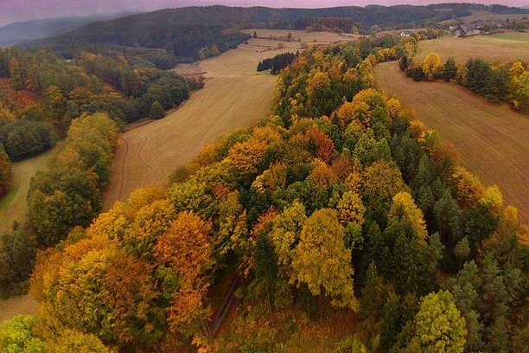
Dispersal limits
Species may be missing in parts of its range (B, C) and niche (E) because it can’t get there due to barriers or poor dispersal.
X
Connecticut, USA
Czech Republic, EU
Ricklefs & Schluter (1993), Keil & Chase (2019) Nature Ecology & Evolution
map from NASA (public domain)
Notes:
In this panel we can probably all agree that biodiversity is one of the most valuable natural resources.
But things like climate change or habitat loss are a threat to biodiversity, to the extent that we hear about biodiversity crisis, or sixth mass extinction
For example, about 1% of vertebrate species have gone extinct because of humans

Slide 29
Habitats, land cover classes, biomes
Habitat = species-specific, physical manifestation of species’
niche
Habitat type or biotope = for whole assemblages
… the semantics is a bit loose and messy.
Chytrý et al. (2010)
Notes:
In this panel we can probably all agree that biodiversity is one of the most valuable natural resources.
But things like climate change or habitat loss are a threat to biodiversity, to the extent that we hear about biodiversity crisis, or sixth mass extinction
For example, about 1% of vertebrate species have gone extinct because of humans

Slide 30
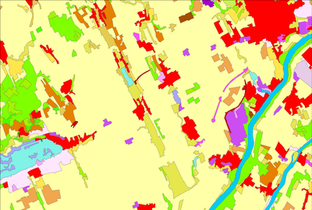
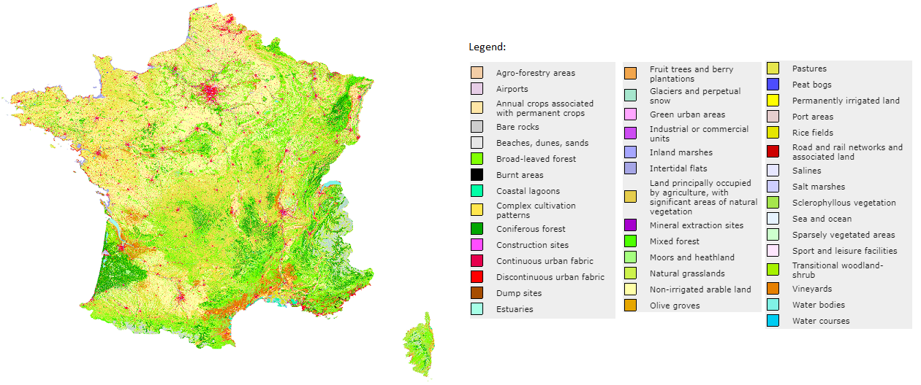
Habitats, land cover classes, biomes
Europe CORINE Land Cover: https://land.copernicus.eu/pan-european/corine-land-cover
Global GlobCover, MODIS, GLC2000, DISCover: http://www.earthenv.org/landcover
Notes:
In this panel we can probably all agree that biodiversity is one of the most valuable natural resources.
But things like climate change or habitat loss are a threat to biodiversity, to the extent that we hear about biodiversity crisis, or sixth mass extinction
For example, about 1% of vertebrate species have gone extinct because of humans

Slide 31
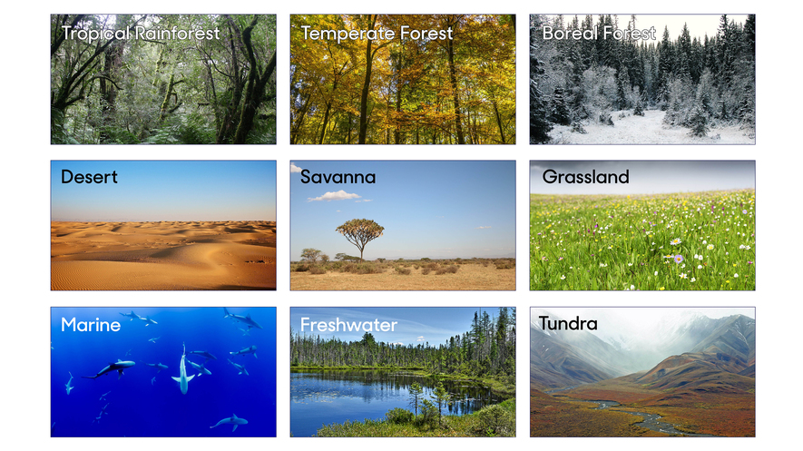
Habitats, land cover classes, biomes
Biomes of the world, source: https://en.wikipedia.org/wiki/Biome
Notes:
In this panel we can probably all agree that biodiversity is one of the most valuable natural resources.
But things like climate change or habitat loss are a threat to biodiversity, to the extent that we hear about biodiversity crisis, or sixth mass extinction
For example, about 1% of vertebrate species have gone extinct because of humans

Slide 32
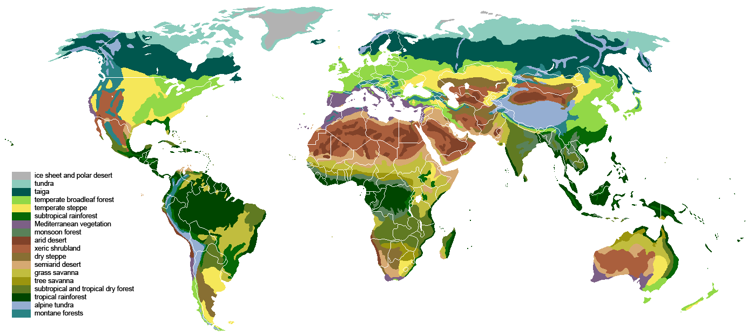
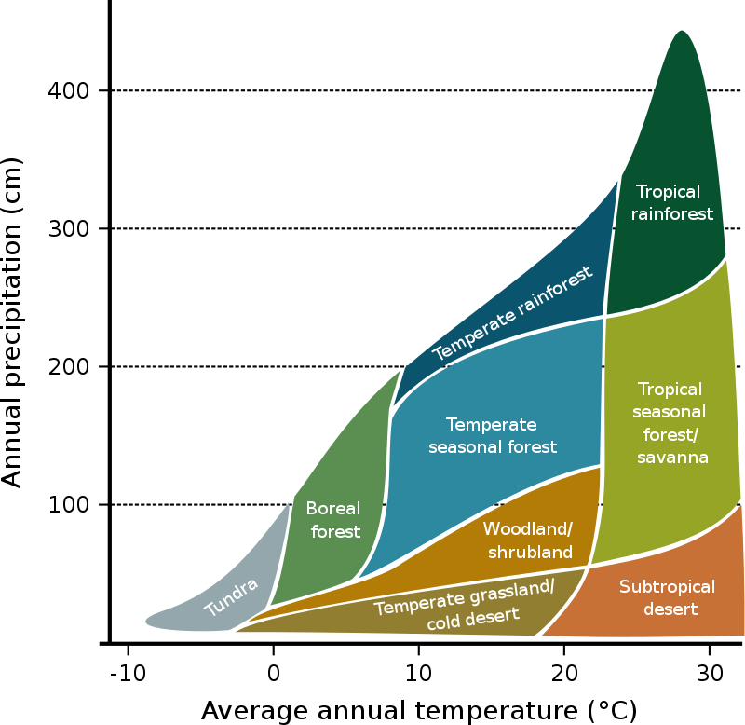
Habitats, land cover classes, biomes
Biomes of the world, source: https://en.wikipedia.org/wiki/Biome
Notes:
In this panel we can probably all agree that biodiversity is one of the most valuable natural resources.
But things like climate change or habitat loss are a threat to biodiversity, to the extent that we hear about biodiversity crisis, or sixth mass extinction
For example, about 1% of vertebrate species have gone extinct because of humans

Slide 33
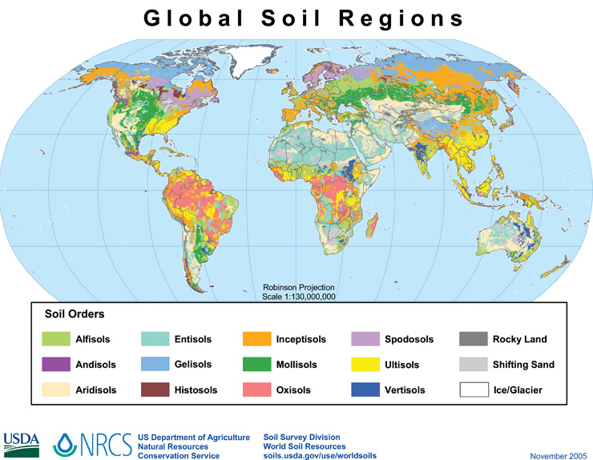
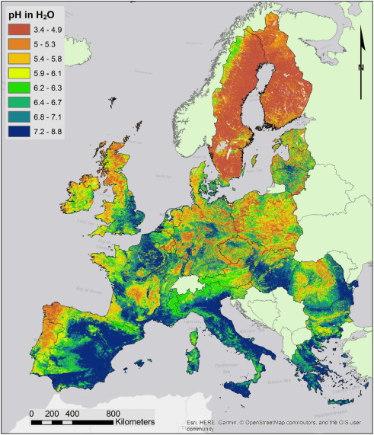
Geology, soils, pH
Ballabio et al. (2019) Geoderma
Notes:
In this panel we can probably all agree that biodiversity is one of the most valuable natural resources.
But things like climate change or habitat loss are a threat to biodiversity, to the extent that we hear about biodiversity crisis, or sixth mass extinction
For example, about 1% of vertebrate species have gone extinct because of humans

Slide 34
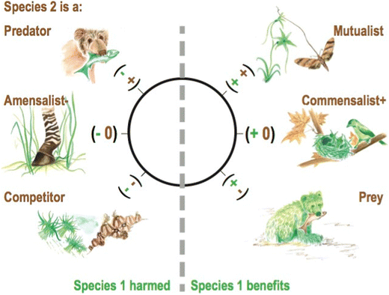
Biotic (interspecific) interactions
Species may be missing in parts of its range (B, C) and niche (E) because of other species
McCann & Gellner (2020) Theoretical Ecology
Notes:
In this panel we can probably all agree that biodiversity is one of the most valuable natural resources.
But things like climate change or habitat loss are a threat to biodiversity, to the extent that we hear about biodiversity crisis, or sixth mass extinction
For example, about 1% of vertebrate species have gone extinct because of humans

Slide 35
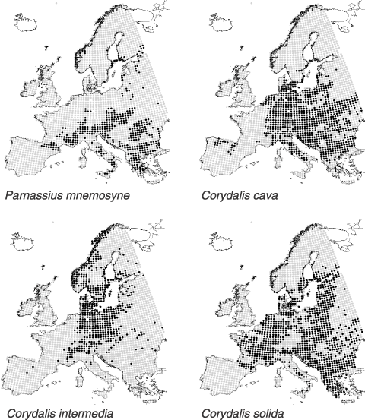
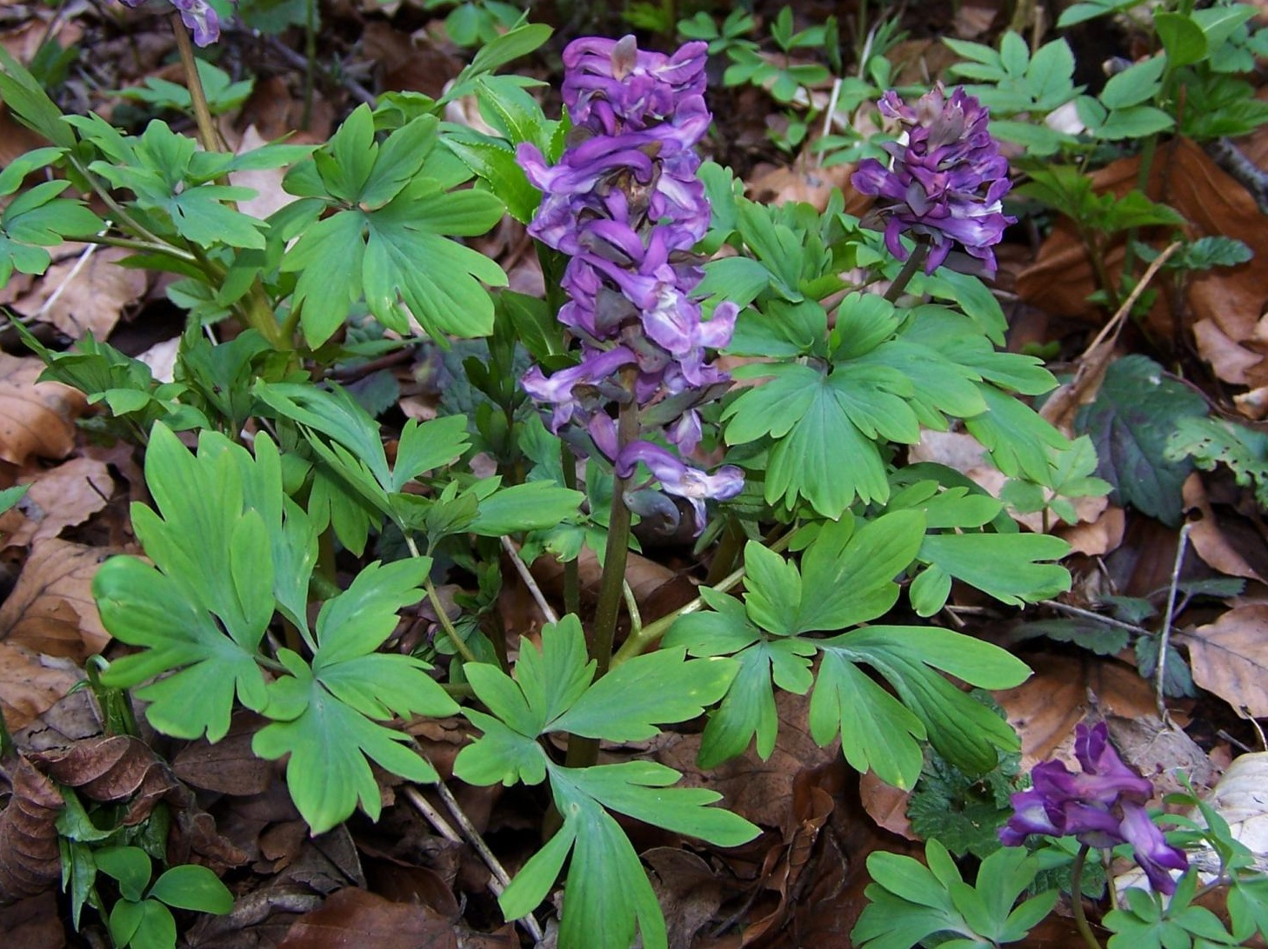
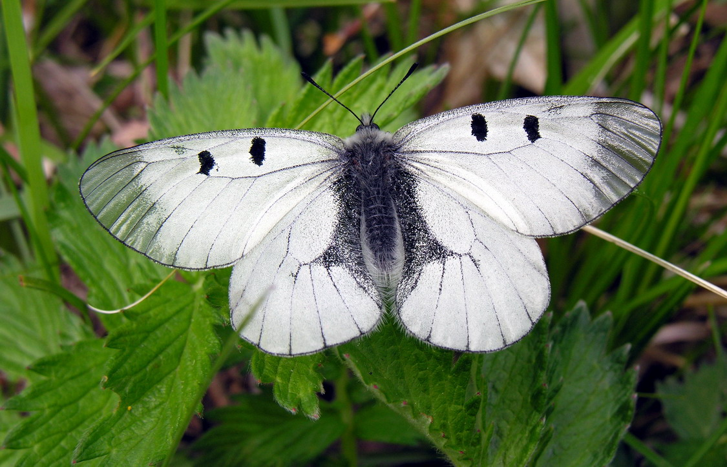
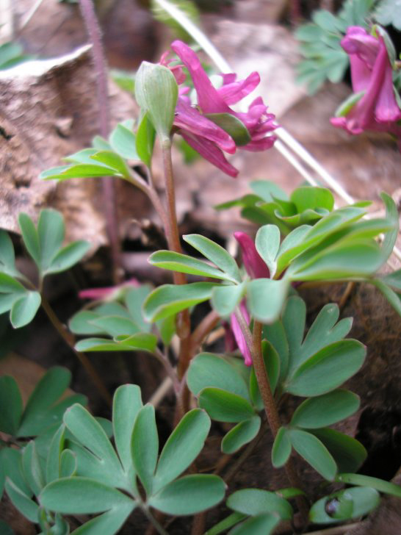
Biotic (interspecific) interactions
Araújo & Luoto (2007) Global Ecology and Biogeogrpahy
Photos: Wikipedia
Notes:
In this panel we can probably all agree that biodiversity is one of the most valuable natural resources.
But things like climate change or habitat loss are a threat to biodiversity, to the extent that we hear about biodiversity crisis, or sixth mass extinction
For example, about 1% of vertebrate species have gone extinct because of humans

Slide 36
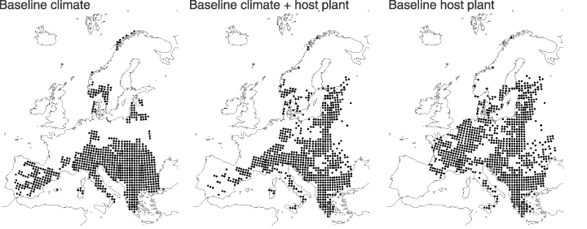
Biotic (interspecific) interactions
Araújo & Luoto (2007) Global Ecology and Biogeogrpahy
Notes:
In this panel we can probably all agree that biodiversity is one of the most valuable natural resources.
But things like climate change or habitat loss are a threat to biodiversity, to the extent that we hear about biodiversity crisis, or sixth mass extinction
For example, about 1% of vertebrate species have gone extinct because of humans

Slide 37
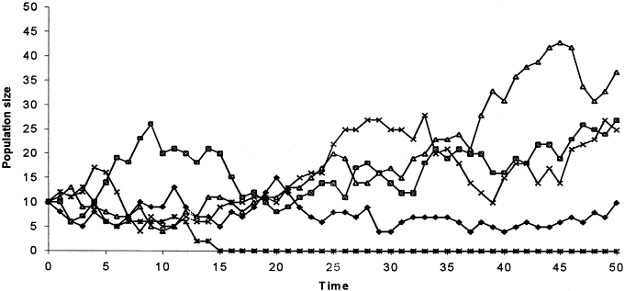
Demographic stochasticity
Species may be missing in parts of its range (B, C) and niche (E) because of random fluctuations of its population size due to randomness in birth and death (= demographic processes)
Applies particularly to areas/species with small populations
Notes:
In this panel we can probably all agree that biodiversity is one of the most valuable natural resources.
But things like climate change or habitat loss are a threat to biodiversity, to the extent that we hear about biodiversity crisis, or sixth mass extinction
For example, about 1% of vertebrate species have gone extinct because of humans

Slide 38
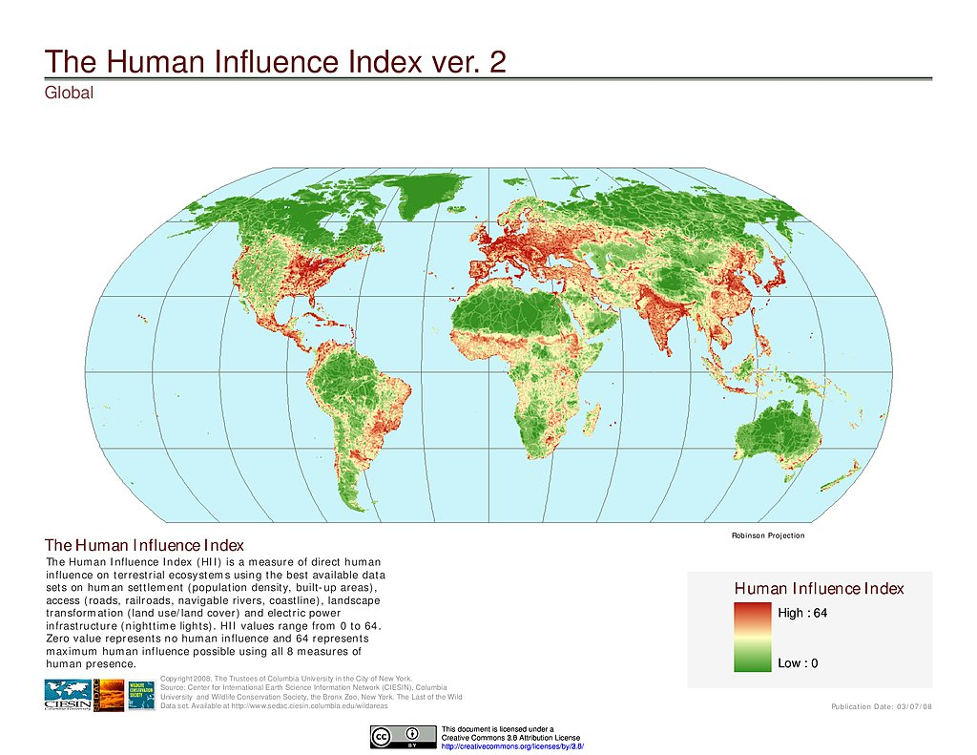
Humans
https://sedac.ciesin.columbia.edu/
Notes:
In this panel we can probably all agree that biodiversity is one of the most valuable natural resources.
But things like climate change or habitat loss are a threat to biodiversity, to the extent that we hear about biodiversity crisis, or sixth mass extinction
For example, about 1% of vertebrate species have gone extinct because of humans

Slide 39
Thank you. Questions?

